Slide 1
Linked-List Allocation Using a Table in Memory, I-nodes (index nodes)
Presenter: Ayush Tuladhar

Slide 2
Introduction to File Allocation
Determines how files are stored on disk
Contiguous Allocation
Linked List Allocation
Indexed Allocation (I-nodes)

Slide 3
Why Allocation Matters?
Efficient disk space use
Fast access time
Support for file growth
Minimize fragmentation

Slide 4
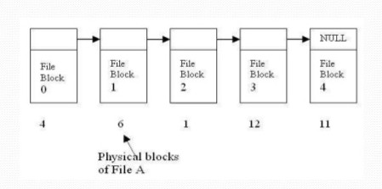
Linked List Allocation: Concept
Store each file as a linked list of disk blocks
Each block contains:
File data
Pointer to the next block

Slide 5
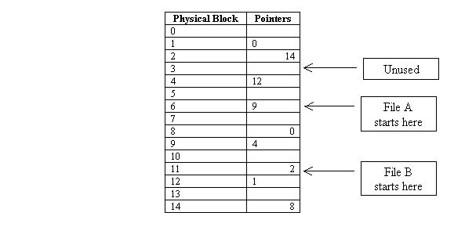
Linked List Allocation in Table (FAT)
Instead of using pointers inside blocks, pointers are kept in a File Allocation Table (FAT)
FAT resides in memory (RAM)
Each entry in FAT has:
Index: block number
Value: next block in file or EOF

Slide 6
Advantages of FAT Approach
Faster access due to in-memory table
Easy traversal
No pointer overhead in disk blocks
Supports dynamic file sizes

Slide 7
Advantages of FAT Approach
Faster access due to in-memory table
Easy traversal
No pointer overhead in disk blocks
Supports dynamic file sizes

Slide 8
Disadvantages of FAT
Entire FAT must be in memory
Random access is slow (must traverse)
Can suffer from fragmentation
Large disks = Large FAT

Slide 9
I-nodes (Index Nodes): Concept
Used in UNIX/Linux file systems
Each file has an I-node containing:
File metadata (size, permissions, timestamps)
Pointers to data blocks

Slide 10
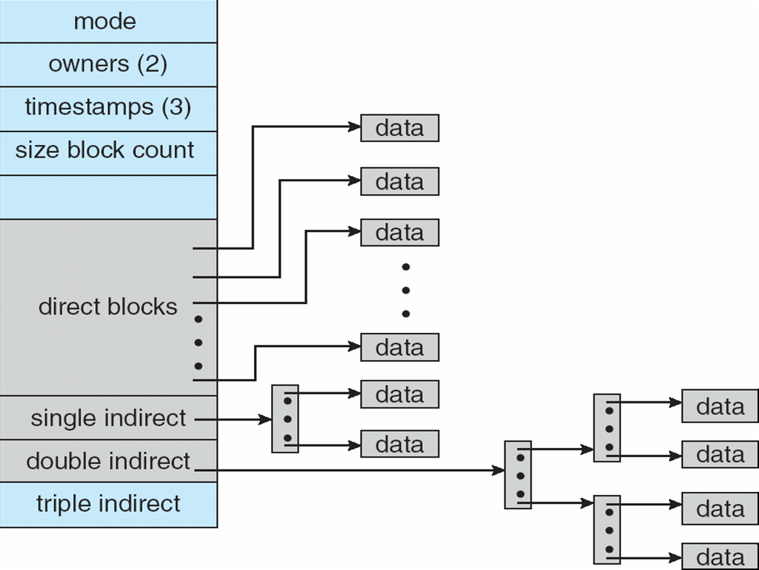
Structure of an I-node
Direct Blocks (12): Point to first 12 data blocks.
Single Indirect Block: Points to a block of pointers (extra level).
Double Indirect Block: Two levels of pointers.
Triple Indirect Block (if needed): Three levels.

Slide 11
Advantages of I-nodes
Efficient for small and large files
Easy to manage metadata
Supports random access
Scalable with multi-level indexing

Slide 12
Disadvantages of I-nodes
Fixed number of pointers limits max file size
Accessing large files needs multiple lookups
I-nodes stored separately (extra seek time)

Slide 13
FAT vs I-nodes: Comparison Table
Feature | FAT | I-nodes
Metadata | Separate from data | Stored in I-node
Access speed | Slower for random | Faster random access
Memory usage | High for large disks | Moderate
Scalability | Poor | Excellent
File growth | Dynamic | Dynamic
Fragmentation | No external fragmentation | Minimal internal fragmentation

Slide 14
Use Cases
FAT: USB drives, simple OS, small storage
I-nodes: UNIX/Linux systems, enterprise storage, cloud servers

Slide 15
Conclusion
Linked List Allocation (FAT): Good for sequential access, simpler systems
I-nodes: Powerful, flexible, scalable for large file systems
Both methods aim to optimize file storage and retrieval

Slide 16
THANK YOU

